Slide 1

NARASARAOPET ENGINEERING COLLEGE
PROJECT
ON
CRIME DATA PREDICTION USING MACHINE LEARNING
Under the Guidance of:
Dr. VVAS Lakshmi
Prof&HOD
Submitted By:
Maddi Chidananda Dedeepya (22471A4432)
Thoka Asha Gayathri (22471A4452)
Ubbathoti Venkateswarlu (22471A4454)

Slide 2

Abstract
Crime is a major challenge that affects public safety and social development. Traditional crime analysis methods are reactive in nature, as they focus only on past crime records and fail to predict future crime trends. With the availability of large crime datasets from sources like the National Crime Records Bureau (NCRB), machine learning techniques can be used to analyze patterns and predict crime occurrences.
This project proposes a Crime Data Prediction System using Machine Learning to identify crime trends and high-risk areas. The system collects historical crime data, performs data preprocessing, extracts important features such as population, literacy rate, and unemployment, and applies machine learning models like Logistic Regression, Decision Tree, Random Forest, and Support Vector Machine. The models are evaluated using performance metrics such as accuracy and precision. The best performing model is deployed using a Streamlit dashboard for visualization.
This system helps law enforcement agencies and policymakers take proactive decisions and improve public safety.

Slide 3
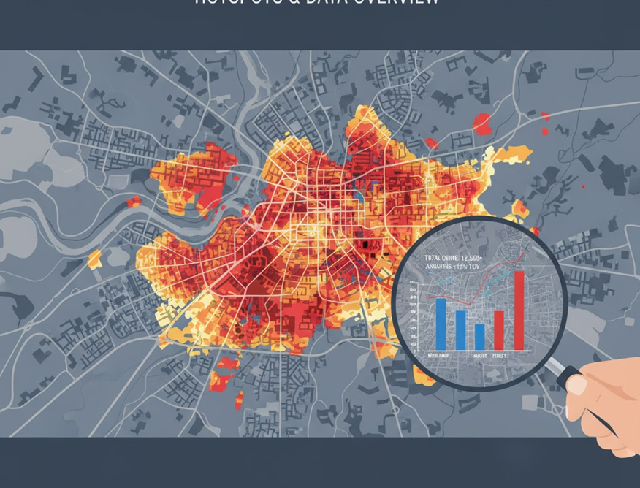
Introduction
A Major Challenge: Crime significantly impacts societal safety and economic development
Limitations of Tradition: Conventional analysis is reactive, relying only on past data without forecasting future trends.
The Data Advantage: Digital records now enable us to extract deep insights using data-driven techniques.
Machine Learning Power: ML uncovers hidden patterns to accurately predict crime hotspots and trends.
Proactive Impact: Supports police & policymakers in planning and moving from reaction to prevention.

Slide 4
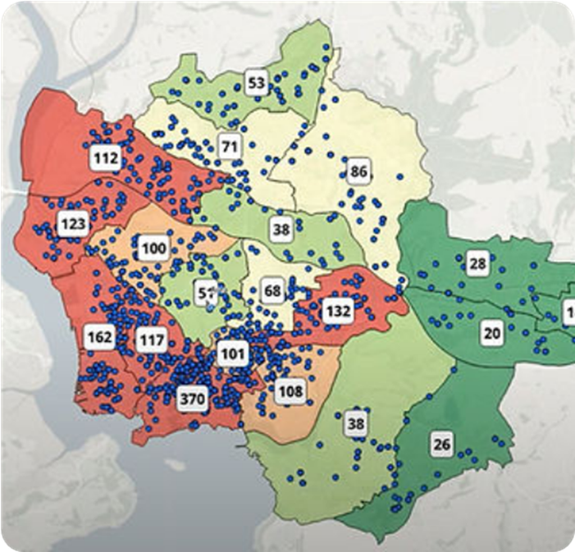

Problem Statement
Current limitations in crime analysis and forecasting
Reactive vs. Predictive
Past-Centric Reporting
Underutilized Data
Crime analysis today is largely reactive, addressing incidents only after they occur.
Reports describe historical data but fail to indicate where the next incident might happen.
Vast amounts of data from NCRB and police logs remain untapped for strategic insight.
Lack of Tools
Resource & Response Gap
Law enforcement lacks specialized tools for accurate, data-based forecasting.
Without prediction, resources are wasted on untargeted patrols, leading to delayed responses.

Slide 5

Objectives
To develop a Machine Learning–based system that can analyze historical crime data and predict future crime patterns for proactive safety measures.
Data Collection: Gather and clean crime datasets from NCRB and reliable sources.
Feature Analysis: Identify socio-economic and demographic factors influencing crimes.
Model Development: Train ML models like Logistic Regression, Random Forest, and LSTM.
Model Evaluation: Compare performance using accuracy, precision, and RMSE metrics.
Deployment: Build an interactive Streamlit web app for visualization.
Decision Support: Help policymakers make data-driven, proactive decisions.

Slide 6
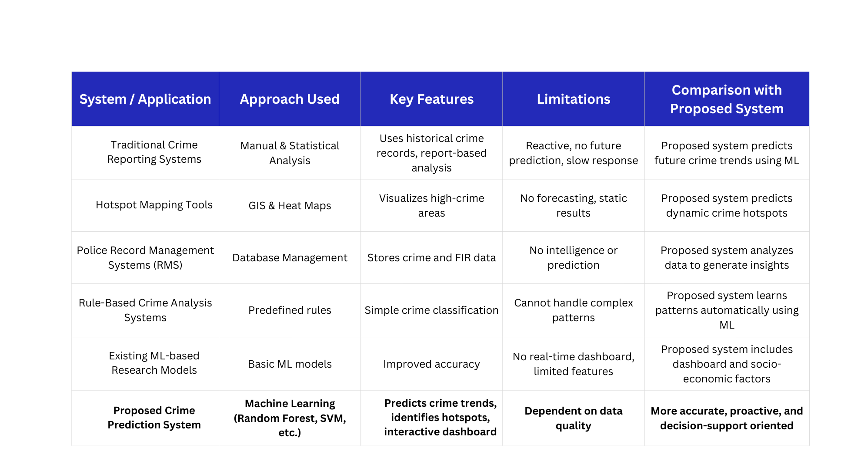
Literature Review

Slide 7

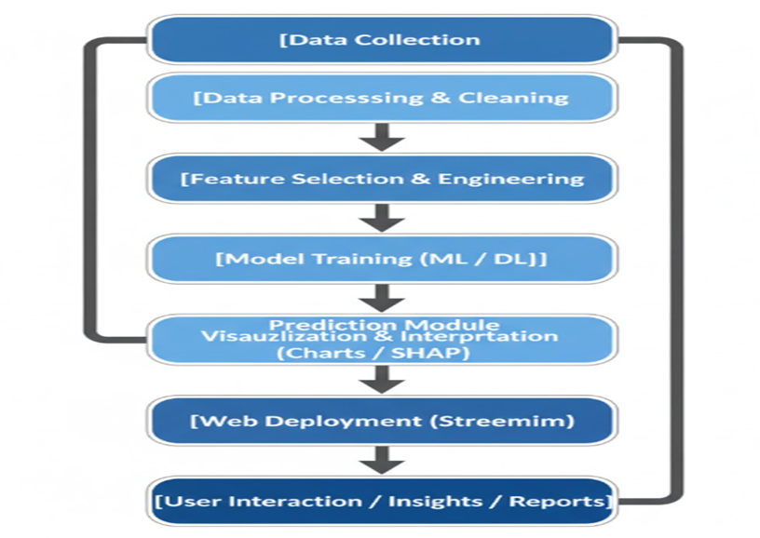
01
Data Collection & Preprocessing
Collect crime records (NCRB), clean data, remove missing values, and prepare for analysis.
Proposed System
Feature Engineering
02
Integrate factors like population, literacy, unemployment, and past crime counts.
03
Model Development
Train ML models (Logistic Regression, Decision Tree, Random Forest, SVM, KNN).
04
Model Evaluation
Compare models using Accuracy, Precision, Recall, F1-score, and RMSE metrics.
05
Dashboard Deployment
Build an interactive Streamlit dashboard for real-time visualization and user access.
06
Decision Support
Provide actionable insights for proactive resource allocation and preventive measures.

Slide 8
Hardware
Software Stack
Standard laptop/PC: Intel i5 (or equiv), 8GB RAM, 100GB Storage. Sufficient for training & dashboard.
Python 3.x with Pandas, NumPy, Scikit-learn, Matplotlib, and Streamlit for full-stack analysis.
Software
&
Hardware Requirements
Operating System
Dev Tools
Cross-platform compatibility: Seamless execution on Windows, Linux, or macOS environments.
Jupyter Notebook for experimentation and VS Code for robust coding, debugging, and version control.
Dashboard
Connectivity
Streamlit framework deployment for an interactive, user-friendly interface for crime prediction.
Stable internet for datasets/APIs. GitHub for version control and collaborative development.

Slide 9


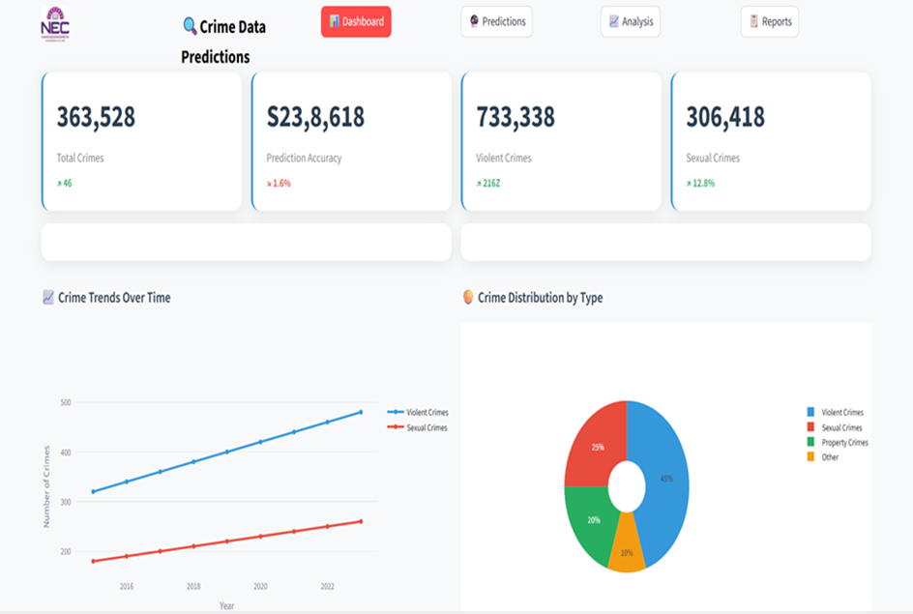
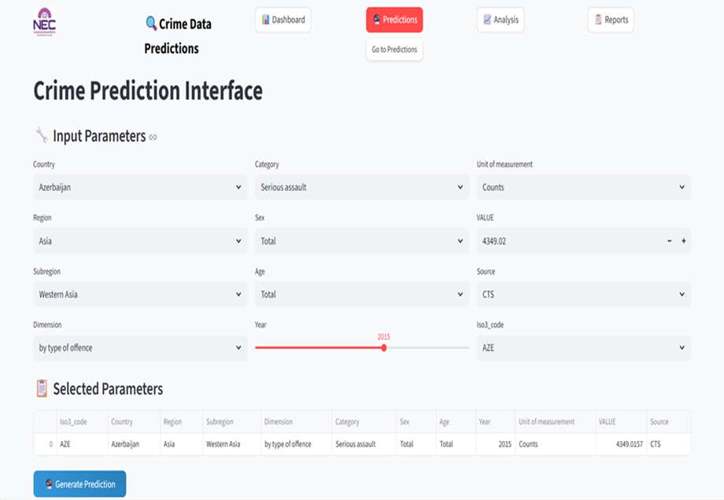
Results

Slide 10
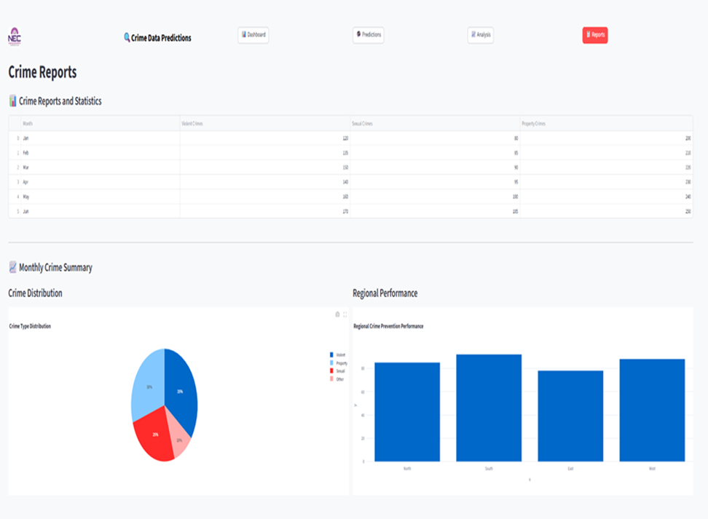
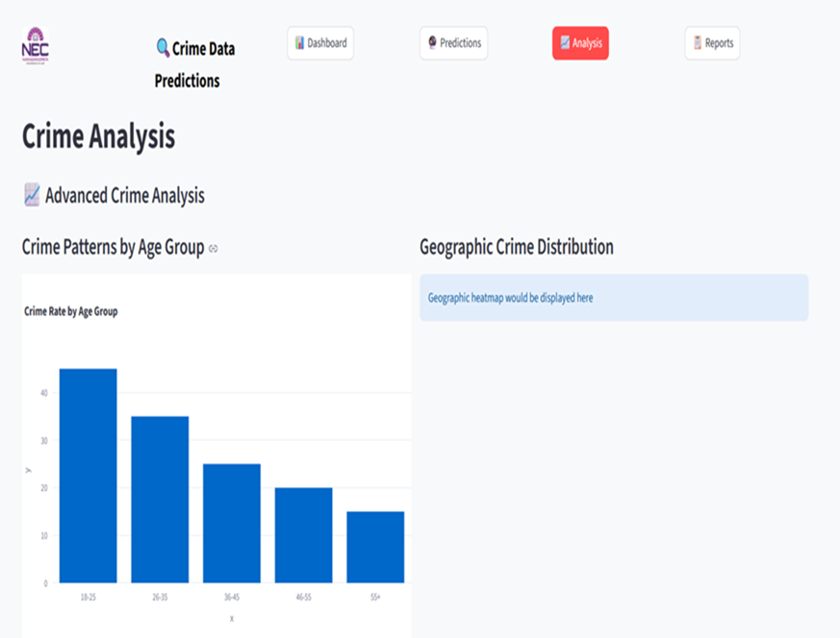
Results

Slide 11
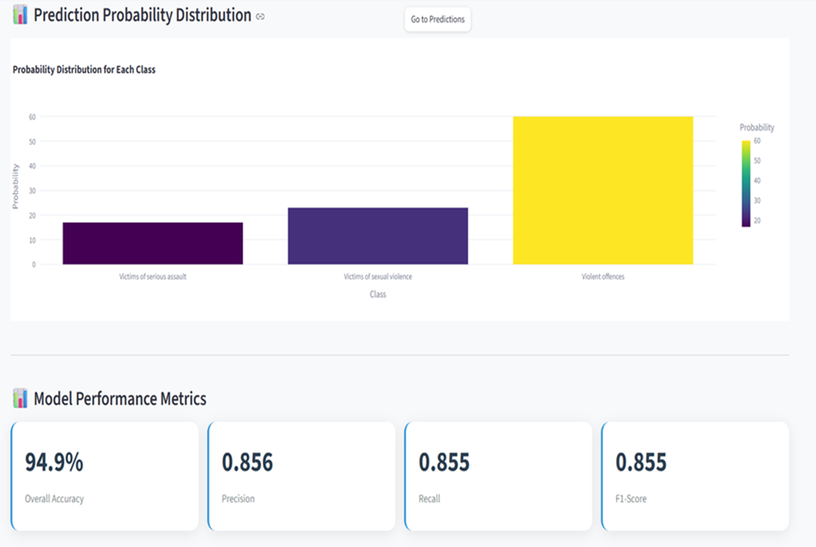
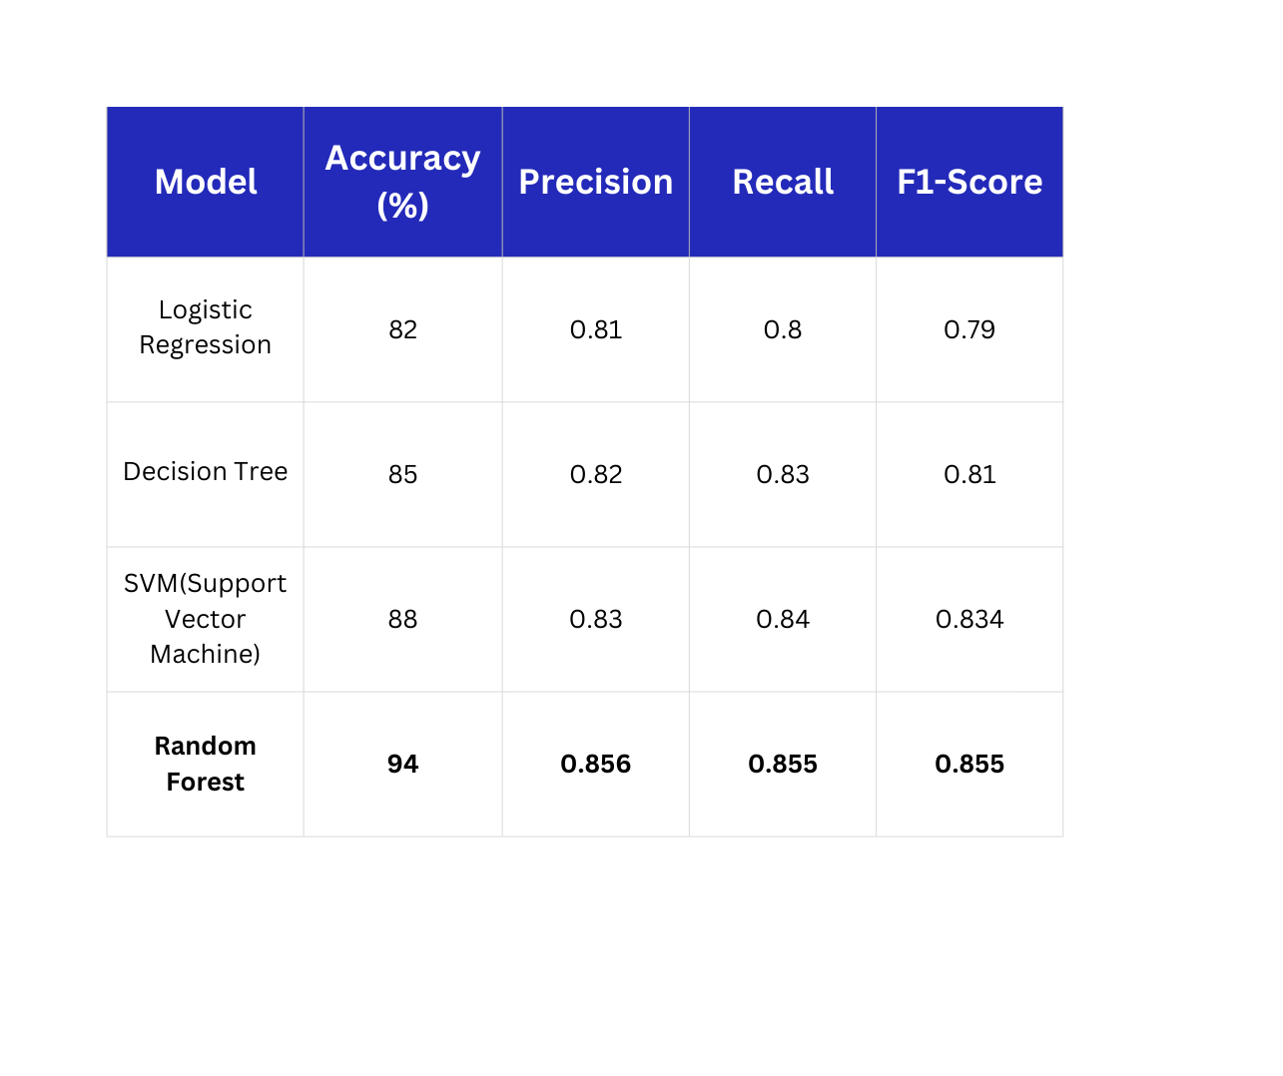
Analysis

Slide 12
Conclusion
ML-Based Prediction
Deployment
Developed a robust predictive model, with Random Forest consistently achieving the best performance and accuracy.
Implemented a fully interactive and user-friendly web interface via Streamlit, enabling real-time access to insights.
Proactive Decision Support
Empowers police departments and policymakers to take timely, data-driven actions to make communities safer.

Slide 13

Future Scope
Real-Time Integration
Advanced Models
Incorporate IoT sensors and live data streams for instantaneous and timely crime prediction.
Enhance prediction accuracy by developing hybrid Machine Learning Deep Learning architectures.
Cloud & Mobile Deployment
Explainable AI
Scale the system to the cloud to ensure it is accessible to field officers anytime, anywhere.
Integrate interpretability tools to improve transparency and trust.

Slide 14



References & Acknowledgement
Key References
Acknowledgement
UNODC: United Nations Office on Drugs and Crime – Global Crime Statistics (2023).
We extend our sincere gratitude to our Project Guide for their invaluable mentorship, technical insights, and continuous encouragement throughout this research. Special thanks to the Department of CSE(DS) for providing the necessary infrastructure and support.
NCRB: National Crime Records Bureau – Crime in India Reports (Annual Publication).
Research: "Random Forest for Crime Prediction" – Journal of Artificial Intelligence Research.
Methodology: "SHAP Values for Model Interpretability" – Lundberg & Lee (2017).

Slide 15

THANK YOU!

